Slide 1
The Gilded Age
1877-1900

Slide 2
Where does “Gilded Age” come from??
The Gilded Age
by Mark Twain and Charles Dudley Warner
“The gold coating would be the upper class; the elites, their lifestyles; the evolution of democracy; evolution of technology and easiness of lifestyle. The cheap metal being the ground work and dirty hard labor behind all of that by underpaid, under- appreciated, even abused working class who struggle day to day with little money to get by. Depression leads to crime and drinking and so those rates go up. All of this is ignored by the public eye, the elites and ruling class ignore it and so it is covered, hidden, and fake. Fake as in not solid gold. Not worth the substance it is really made of...”

Slide 3
Definition of the Gilded Age
The time period from 1877 to 1900 when the U.S. experienced rapid industrial growth that led to poverty, corruption and a large gap between the wealthy and poor.

Slide 4
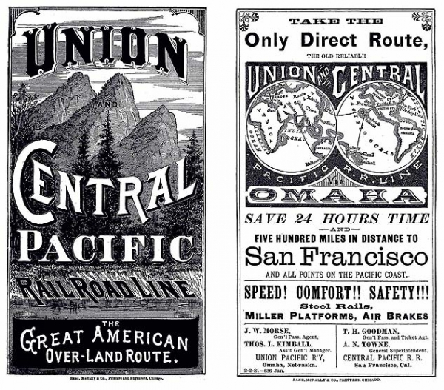
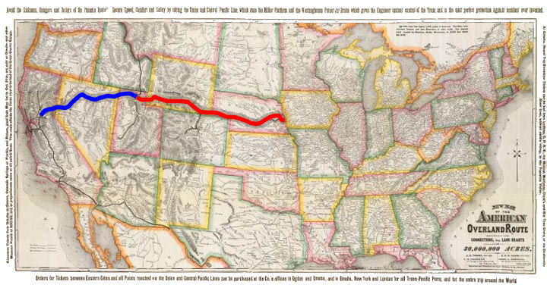
How Does It Begin??
The Gilded Age begins with the completion of the transcontinental railroad, linking east and west and providing much-needed resources from the West to the industries in the Northeast.

Slide 5
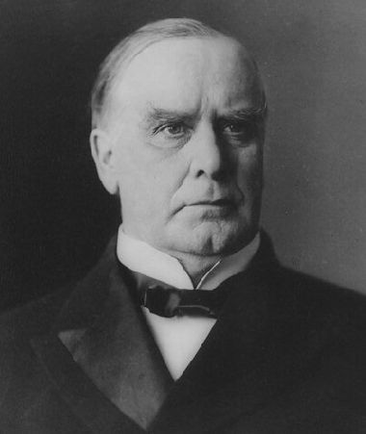
What’s Happening in This Time?
Laissez-faire – No government regulation or interference in the rise of businesses. (hands-off)
Monopoly – total control of a type of industry by one person or company.
Protective Tariff (McKinley Tariff)- High tax on imports designed to protect American manufacturers.

Slide 6
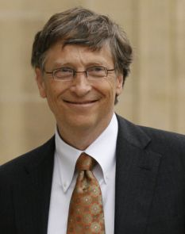
Who Is the Richest Man Today??
Bill Gates, who made his fortune on the creation of Microsoft Windows Software.
Currently, he has $85.4 billion.
OR
Amazon founder Jeff Bezos.
Currently, he has $83.7 billion.

Slide 7
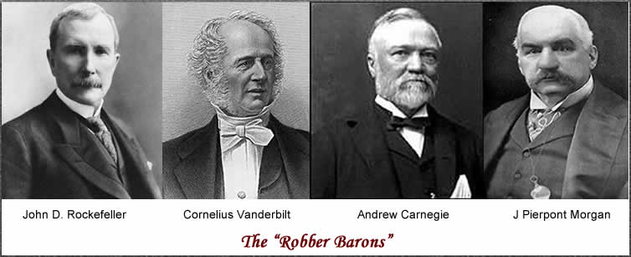
The Robber Barons
Those entrepreneurs who create the industrialized America of the Gilded Age.

Slide 8
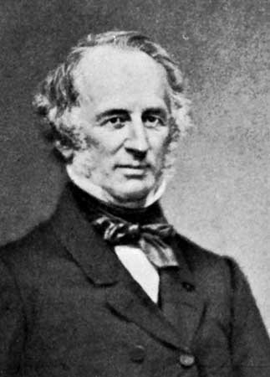
Cornelius Vanderbilt
Creates a huge industry by controlling the major railroad lines.
In his lifetime, he made $178.4 billion (today’s money)
He was the first to begin the takeover of an industry, although he wasn’t successful in monopolizing the entire railroad industry.

Slide 9
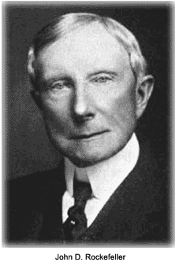
John D. Rockefeller
He began the takeover of the oil industry after the Civil War.
He got his start from doing business with Vanderbilt.
He initially had control of the oil refineries and then created Standard Oil.
He is the richest man in history up to this point.
In his lifetime, he made $663.4 billion (today’s money).
Standard Oil was one of the trusts broken up by Teddy Roosevelt.

Slide 10
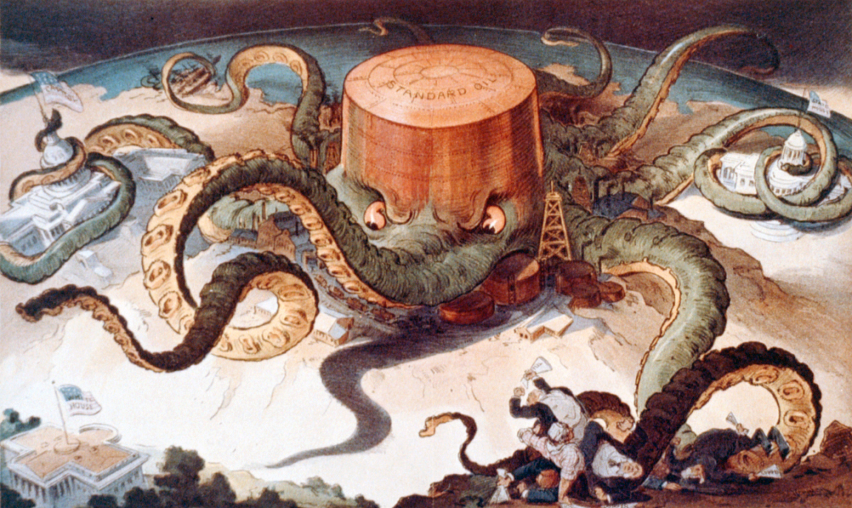

Slide 11
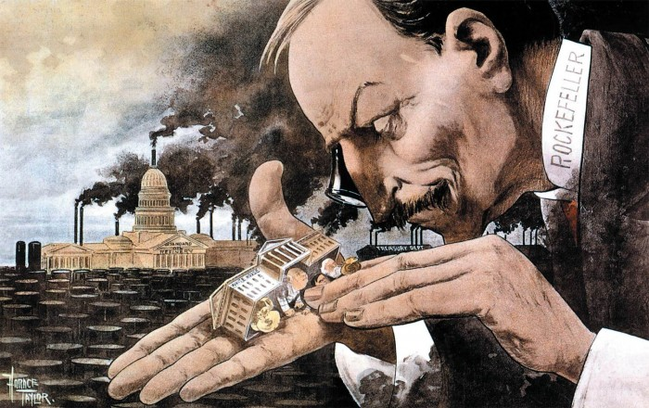

Slide 12
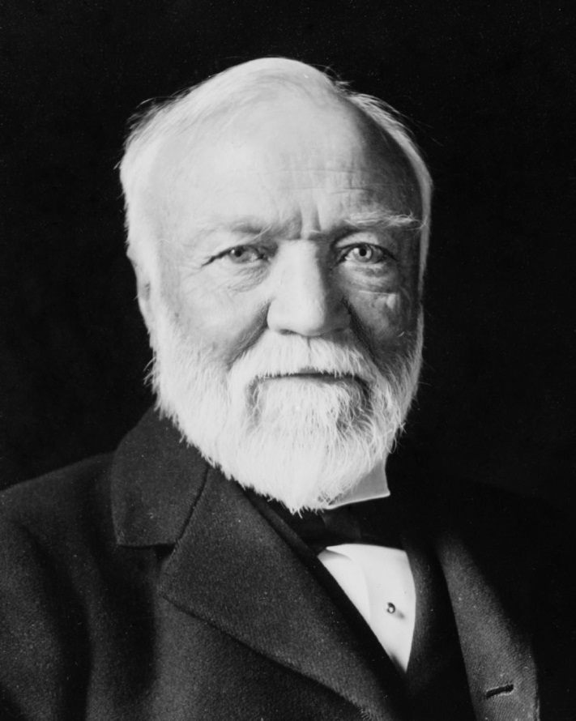
Andrew Carnegie
He monopolized the steel industry through vertical integration.
He was the first to mass-produce steel using the Bessemer Process.
He eventually sells his entire business to J.P. Morgan.
In his lifetime, he made $297.8 billion (today’s money)

Slide 13
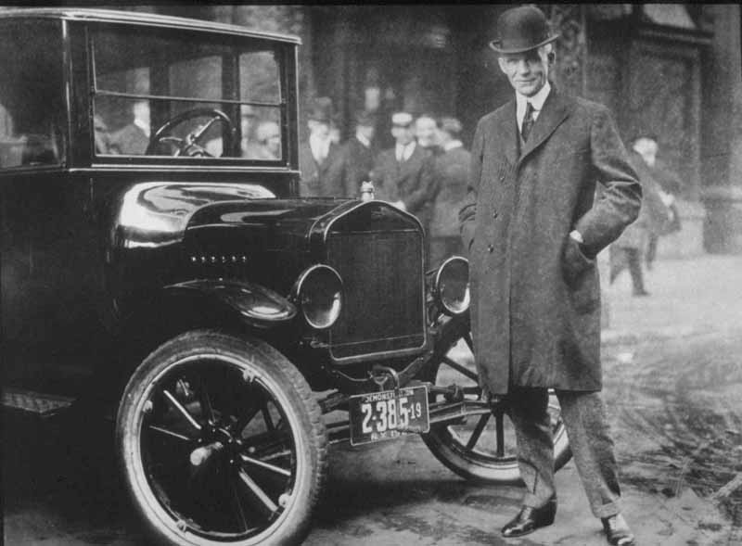
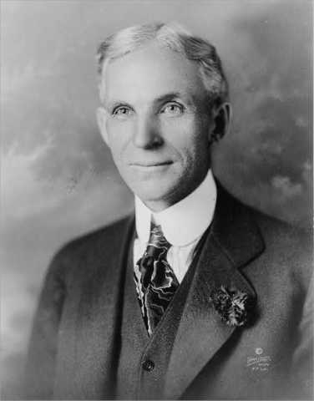
Henry Ford
First to be able to mass-produce the automobile.
The Model T was then available to the common man at $300.
He also perfected the assembly line, which led to the standard 8 hour work day and helped the workers by adopting a minimum wage.
In his lifetime, he made $188.1 billion.

Slide 14
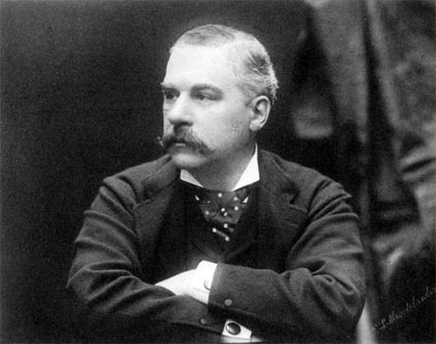
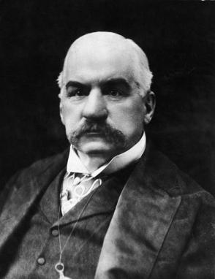
John Pierpont (JP) Morgan
He created his fortune through investing in companies.
He invested in electricity through Thomas Edison, forming the General Electric (GE) Company.
He later bought out Carnegie and created the United States Steel Corporation.
Over his lifetime, he earned $41.5 billion but controlled many companies through investment banking.

Slide 15
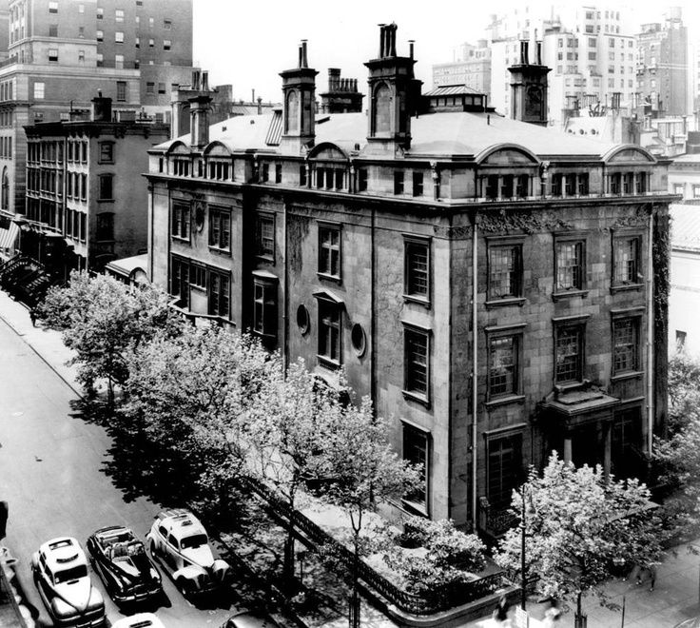
JP Morgan’s Home – Madison Ave. NY

Slide 16
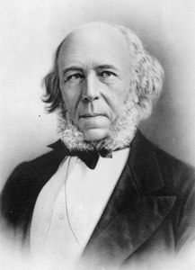
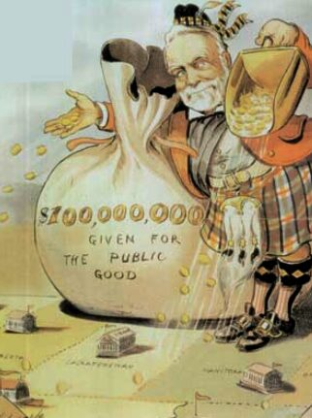
So, How Do You Justify Having So Much Money???
Social Darwinism – Society has evolved through competition and natural selection; only the “fittest” prosper while those who are poor are genetically weak. – Idea created by Herbert Spencer
Gospel of Wealth – Carnegie’s philosophy that wealthy Americans have a responsibility to better society through philanthropy.
Philanthropy -Using great wealth to further social progress.
Carnegie donated millions of dollars to create public libraries and Carnegie Hall
Rockefeller founded the University of Chicago and Rockefeller University and the Rockefeller Institute for Medical Research, which led to the eradication of several diseases including hookworm and yellow fever.

Slide 17
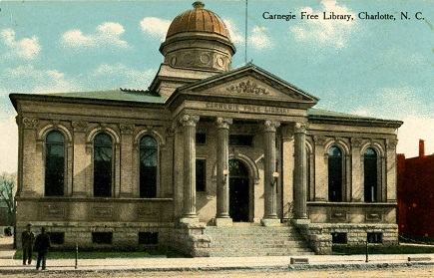
Carnegie Library

Slide 18
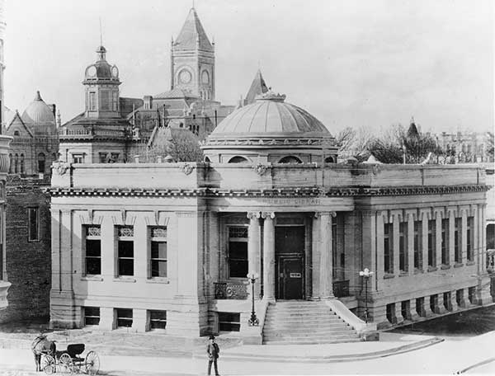
Carnegie Library in California

Slide 20
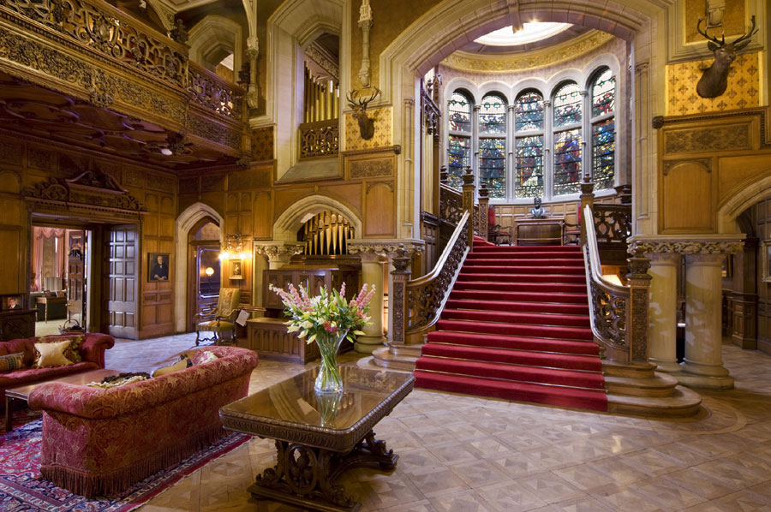
Inside Carnegie’s House

Slide 21
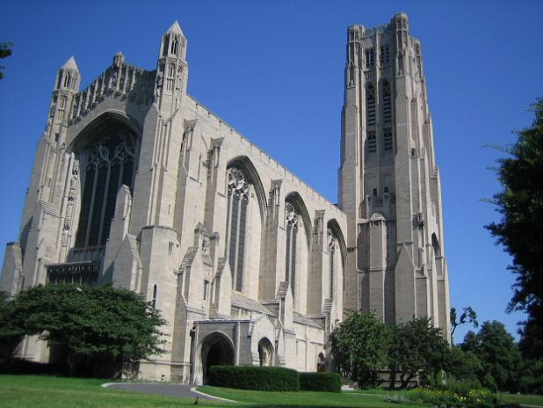
Rockefeller Chapel at University of Chicago

Slide 22
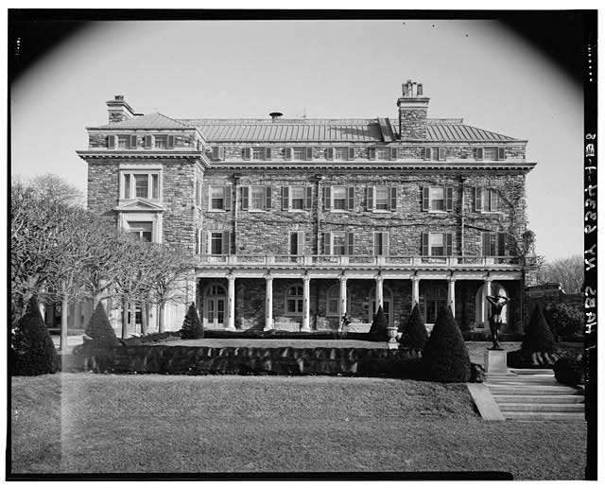

Slide 23
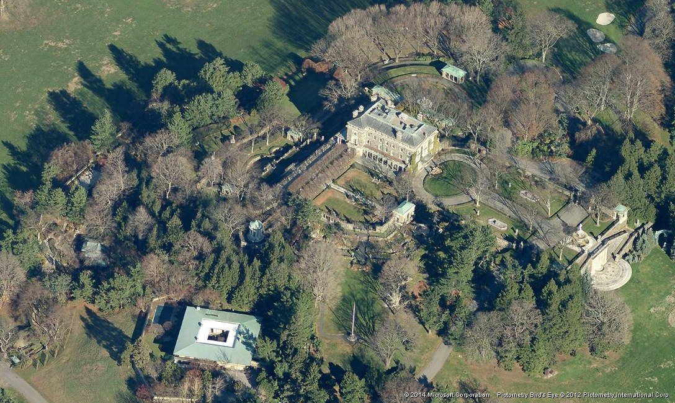

Slide 24
